Slide 1
Action template:
Earned universalism
A pragmatic path to inclusion outcomes for everyone

Slide 2
Earned universalism
An inclusion strategy that offers a practical way forward through:
Focusing on where bias and structural barriers limit performance
Fixing those barriers in ways that strengthen outcomes for everyone
Definition
Source: A new path to inclusion: Earned universalism. (2026). Catalyst.

Slide 3
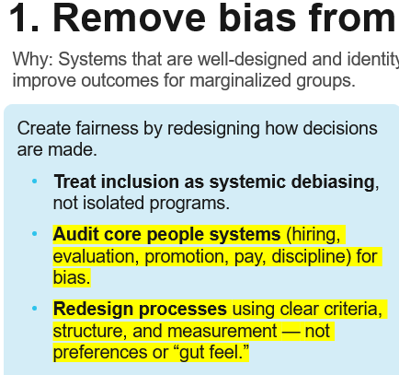
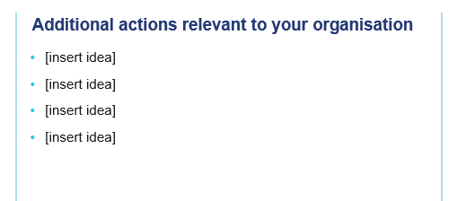
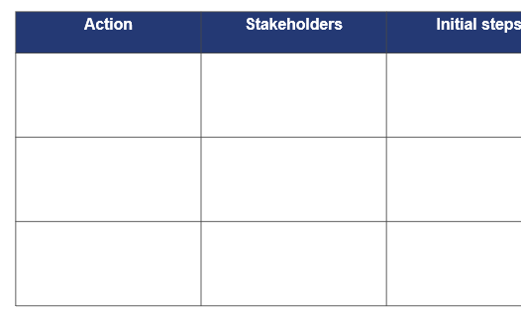
How to use this template
For each section, review the suggested actions on the left side of the slide. Highlight ones that feel most relevant.
In the blank text box on the right, add additional actions that are most relevant to your organization.
In the subsequent slide, select ~3 actions to prioritize. Add stakeholders, initial steps, and a timeline for each. Add more rows or columns as you see fit.

Slide 4
1. Remove bias from systems
Why: Systems that are well-designed and identity-neutral level the playing field for everyone and improve outcomes for marginalized groups.
Create fairness by redesigning how decisions are made.
Treat inclusion as systemic debiasing, not isolated programs.
Audit core people systems (hiring, evaluation, promotion, pay, discipline) for bias.
Redesign processes using clear criteria, structure, and measurement — not preferences or “gut feel.”
Additional actions relevant to your organization
[insert idea]
[insert idea]
[insert idea]
[insert idea]

Slide 5
Remove bias from systems
Copy ~3 priority actions from the previous slide into the left column. Fill out information about stakeholders, initial steps, and timeline. Adjust topics, and add more rows, columns, or slides as needed.
Action | Stakeholders | Initial steps | Timeline

Slide 6
2. Maintain group focus in universal programs
Why: This approach reduces legal risk while still addressing the disparities that made these programs necessary in the first place.
Open access without losing sight of inequities.
Keep programs open to all, but retain identity-relevant themes (e.g., bias, allyship, inclusive leadership).
Shift from cohorts → content (commitment to inclusion).
Shift from cohorts → character (lived experience, values, purpose).
Additional actions relevant to your organisation
[insert idea]
[insert idea]
[insert idea]
[insert idea]

Slide 7
Maintain group focus in universal programs
Copy ~3 priority actions from the previous slide into the left column. Fill out information about stakeholders, initial steps, and timeline. Adjust topics, and add more rows, columns, or slides as needed.
Action | Stakeholders | Initial steps | Timeline

Slide 8
3. Promote gender partnership
Why: Gender partnership goes beyond “allyship” to create mutual investment, better culture, and stronger business outcomes.
Make gender equity everyone’s responsibility — and everyone’s benefit.
Engage people of all genders in advancing equity and culture change.
Dismantle gender stereotypes instead of placing the burden on one group.
Focus on shared accountability and shared gains.
Additional actions relevant to your organisation
[insert idea]
[insert idea]
[insert idea]
[insert idea]

Slide 9
Promote gender partnership
Copy ~3 priority actions from the previous slide into the left column. Fill out information about stakeholders, initial steps, and timeline. Adjust topics, and add more rows, columns, or slides as needed.
Action | Stakeholders | Initial steps | Timeline

Slide 10
A new path to inclusion: How to overcome legal and cultural constraints on building fair workplaces
A new path to inclusion toolkit
Report: A new path to inclusion
Infographic: Earned universalism
Executive brief
CHRO talk track: Navigating questions about inclusion efforts
Risks of retreat: The enduring inclusion imperative
Risks of retreat: The path forward
Webinar recording: Risks of retreat
Stop, start, continue: How US organizations should approach inclusion today
Stop, start, continue: PowerPoint templates

